Slide 1

Algorithms Design and Analysis -2
Dynamic Programming
Mayada Hadhoud
Computer Engineering Department
Cairo University
Fall 2016

Slide 2
Agenda
Fibonacci Numbers
Dynamic Programming
Examples:
Coin-row problem
Coin collected robot problem
Rod cutting problem

Slide 3
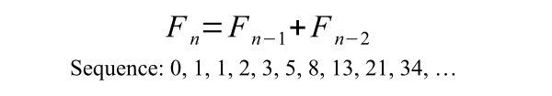
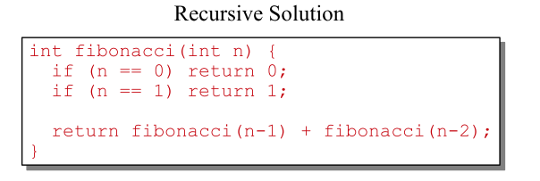

Fibonacci Numbers

Slide 4
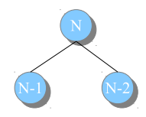
Fibonacci Numbers

Slide 5
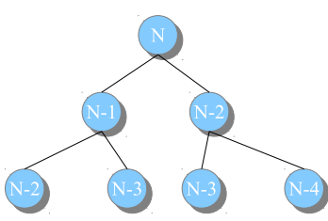
Fibonacci Numbers

Slide 6
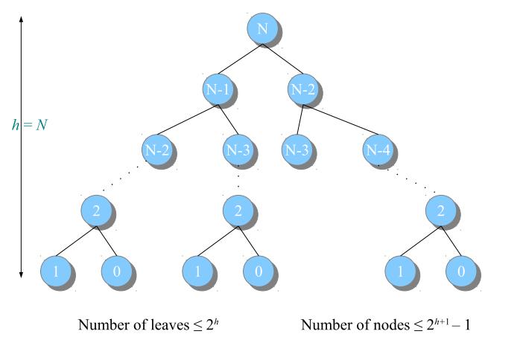

Fibonacci Numbers

Slide 7
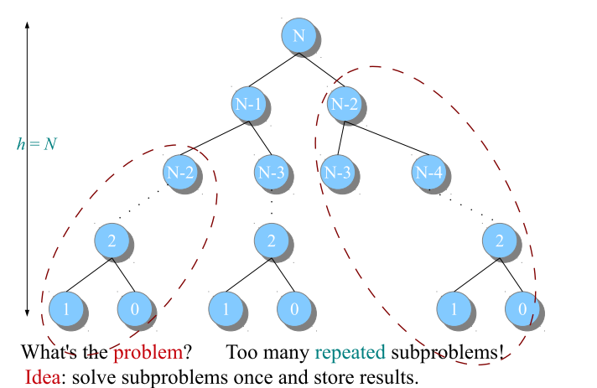
Fibonacci Numbers

Slide 8
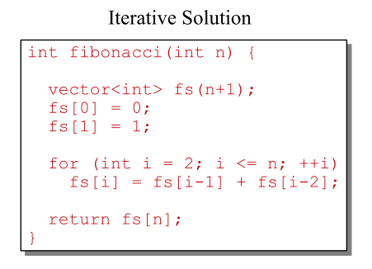
Fibonacci Numbers

Slide 9
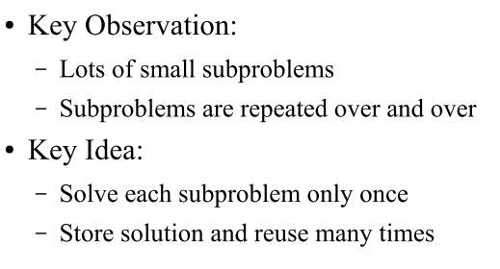
Fibonacci Numbers

Slide 10
Dynamic Programming
A design technique for solving optimization problems by breaking them into simpler subproblems.
Basic idea:
To solve a given problem, we need to solve different parts of the problem (subproblems), then combine the solutions of the subproblems to reach an overall solution.

Slide 11
Dynamic Programming
Dynamic programming approach seeks to solve each subproblem only once (reducing the number of computations). Once the solution to a given subproblem has been computed, it is stored or "memoized": the next time the same solution is needed, it is simply looked up.
This approach is especially useful when the number of repeating subproblems grows exponentially as a function of the size of the input.

Slide 12
Dynamic Programming
Applicable to problems with the following properties:
Overlapping subproblems.
The space of subproblems must be small, that is, any recursive algorithm solving the problem should solve the same subproblems over and over, rather than generating new subproblems.
Optimal substructure.
The solution to a given optimization problem can be obtained by the combination of optimal solutions to its subproblems.
What if the subproblems are not overlapping ???!!!
Notes:
optimal substructures are usually described by means of recursion

Slide 13
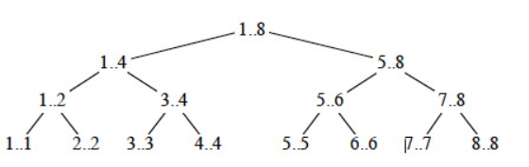
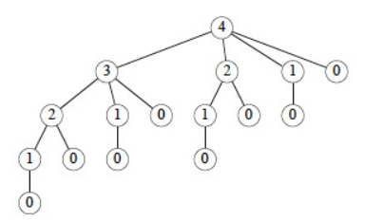
Non overlapping subproblems
Divide and conquer
Overlapping subproblems
Dynamic programming

Slide 14
Dynamic programming
There are 2 ways to implement dynamic programming approach:
Top-down approach:
write the procedure recursively
Save the result of each subproblem (using array, hash table)
The procedure first checks to see if the subproblem has solved previously.
if yes , use the stored results. Else compute it.
Bottom-up approach

Slide 15
Dynamic programming
There are 2 ways to implement dynamic programming approach:
Top-down approach:
Bottom-up approach:
Sort the subproblems by size and solve them in size order, smallest first.
Use their solutions to build on and arrive at solutions to bigger subproblems.
This is also usually done in a tabular form by iteratively generating solutions to bigger and bigger subproblems by using the solutions to small subproblems.

Slide 16
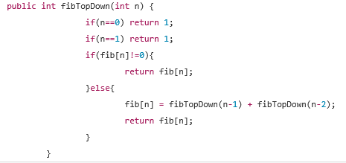
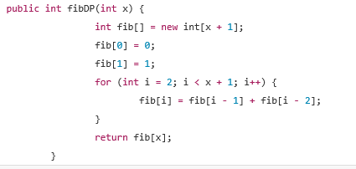

Slide 17
Example: Coin-row problem
There is a row of n coins whose values are some positive integers c₁, c₂,...,cn, not necessarily distinct. The goal is to pick up the maximum amount of money subject to the constraint that no two coins adjacent in the initial row can be picked up.
E.g.: 5, 1, 2, 10, 6, 2. What is the best selection?

Slide 18
Example: Coin-row problem
Let F(n) be the maximum amount that can be picked up from the row of n coins. To derive a recurrence for F(n), we partition all the allowed coin selections into two groups:
those without last coin – the max amount is ? those with the last coin -- the max amount is ? Thus we have the following recurrence
F(n) = max{c_{n} + F(n-2), F(n-1)} for n > 1,
F(0) = 0, F(1)=c₁

Slide 19
Example: Coin-row problem
F(n) = max{c_{n} + F(n-2), F(n-1)} for n > 1,
F(0) = 0, F(1)=c₁
index | 0 | 1 | 2 | 3 | 4 | 5 | 6
coins | -- | 5 | 1 | 2 | 10 | 6 | 2
F( )
Max amount: Coins of optimal solution: Time efficiency: Space efficiency:
Note: All smaller instances were solved.

Slide 20
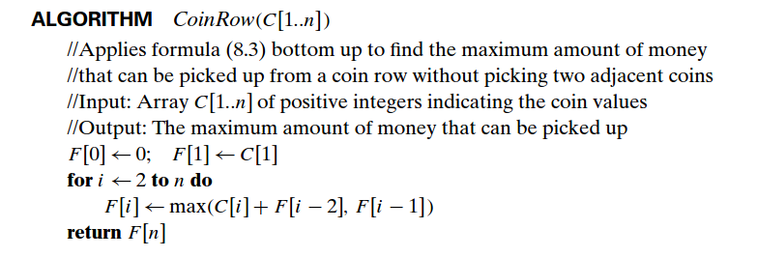
Example: Coin-row problem
Notes:
How to write it top-down

Slide 21
Coin-collecting by robot
Several coins are placed in cells of an n×m board. A robot, located in the upper left cell of the board, needs to collect as many of the coins as possible and bring them to the bottom right cell. On each step, the robot can move either one cell to the right or one cell down from its current location.

Slide 22
Solution to the coin-collecting problem
Let F(i,j) be the largest number of coins the robot can collect and bring to cell (i,j) in the ith row and jth column.
The largest number of coins that can be brought to cell (i,j): from the left neighbor ?
from the neighbor above?
The recurrence:
F(i, j) = max{F(i-1, j), F(i, j-1)} + c_{ij} for 1 ≤ i ≤ n, 1 ≤ j ≤ m
where c_{ij} = 1 if there is a coin in cell (i,j), and c_{ij} = 0 otherwise
F(0, j) = 0 for 1 ≤ j ≤ m and F(i, 0) = 0 for 1 ≤ i ≤ n.

Slide 23
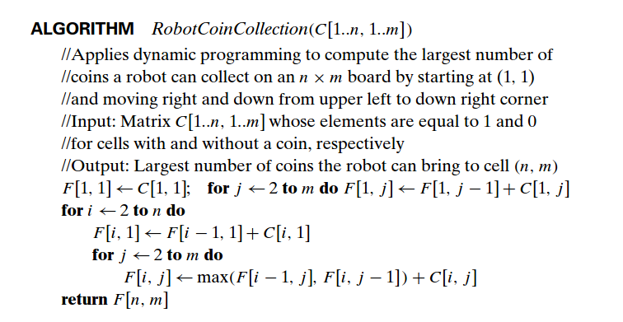
Solution to the coin-collecting problem (cont.)

Slide 24
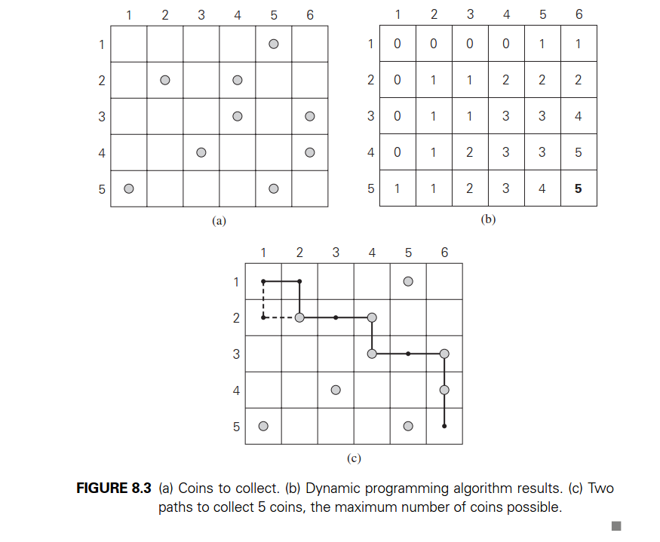

Slide 25
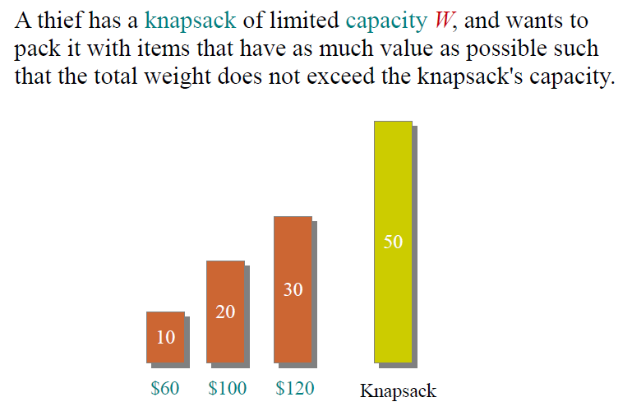
Knapsack Problem

Slide 26
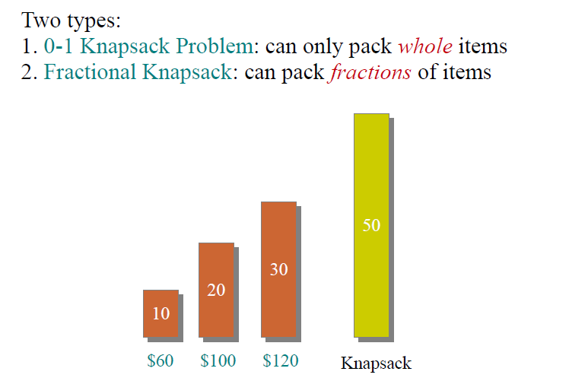
Knapsack Problem

Slide 27
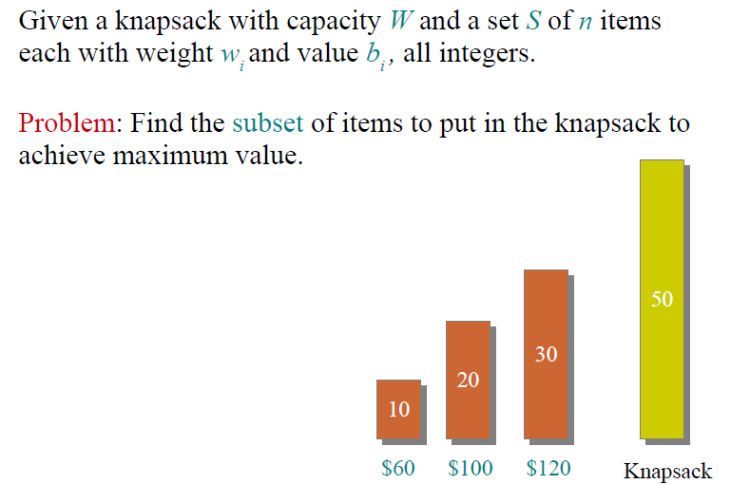
Knapsack Problem

Slide 28
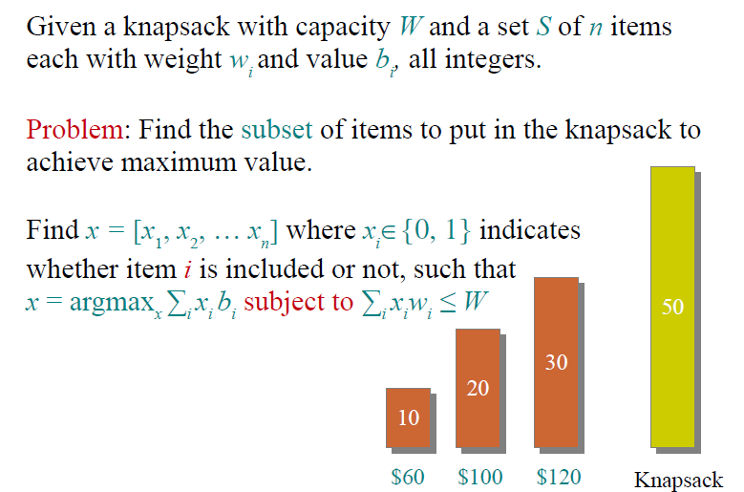
Knapsack Problem

Slide 29
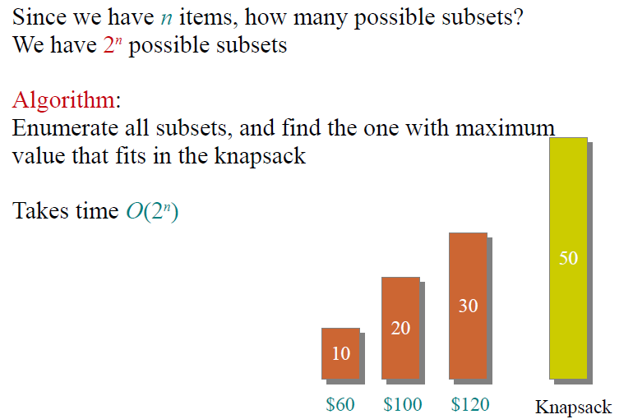
Brute force approach

Slide 30
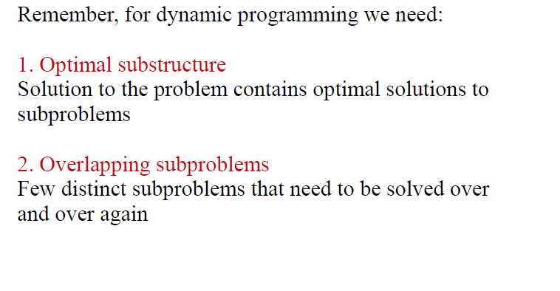
Dynamic Programming Approach

Slide 31
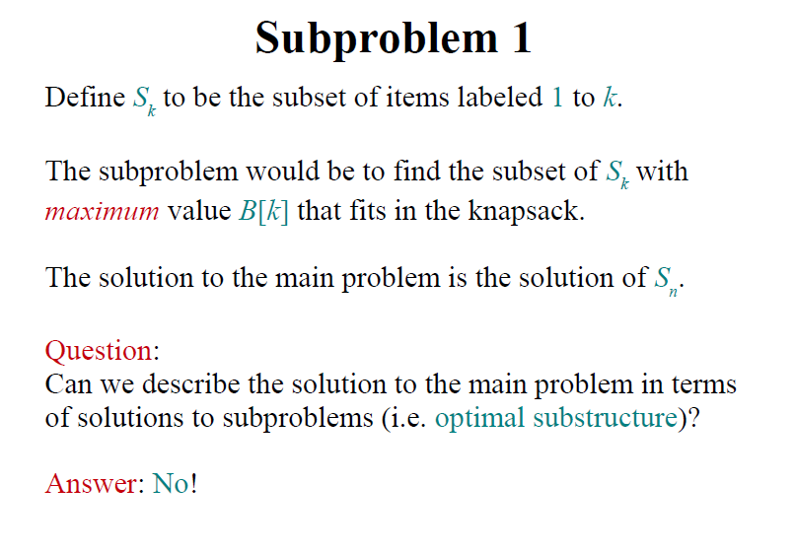

Slide 32
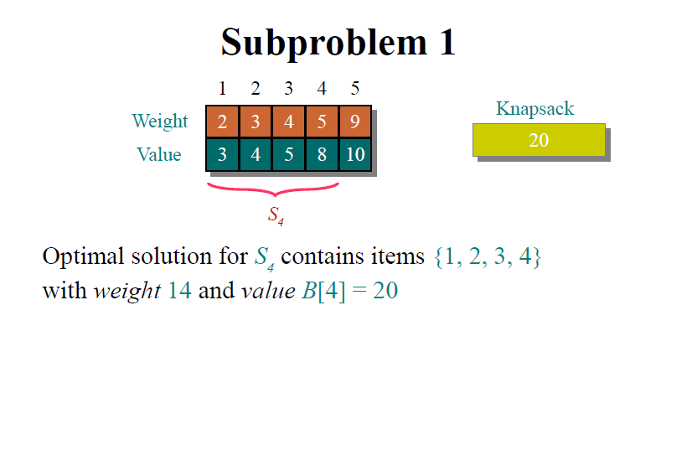

Slide 33
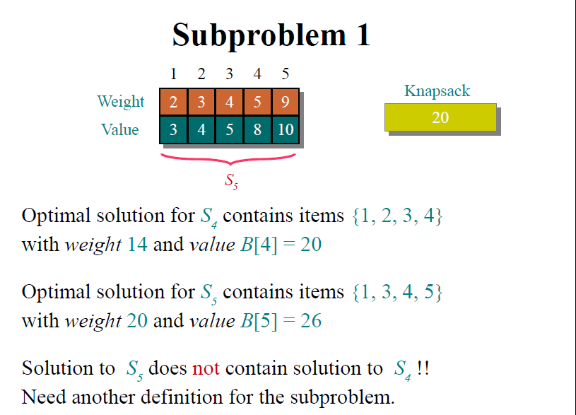

Slide 34
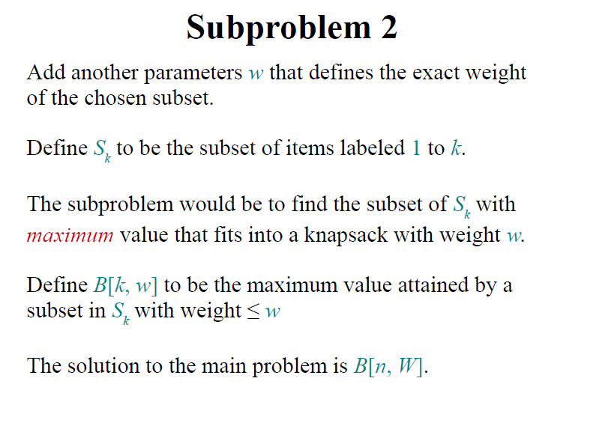

Slide 35
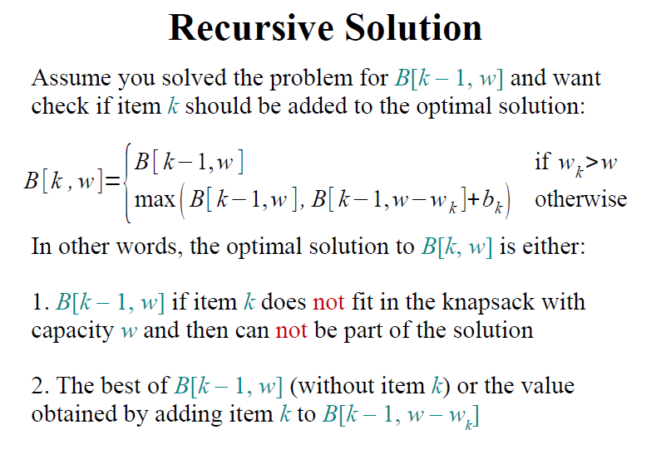

Slide 36
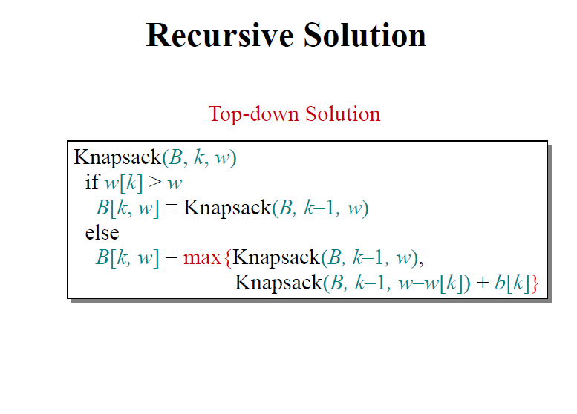

Slide 37
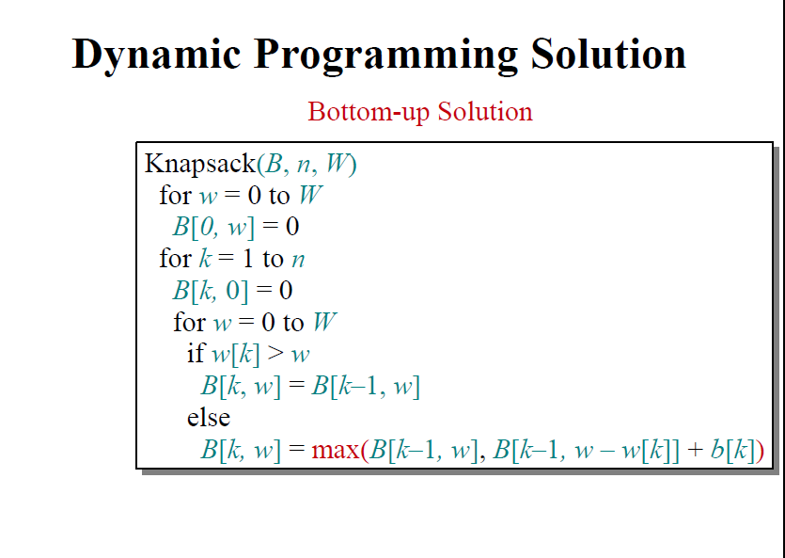

Slide 38
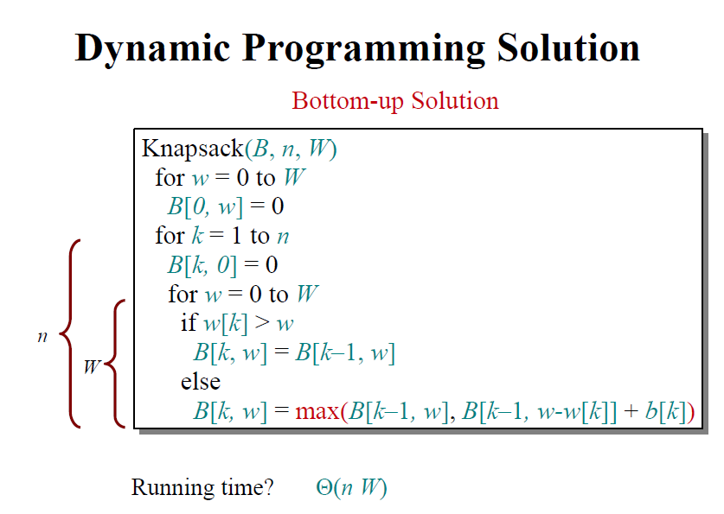

Slide 39
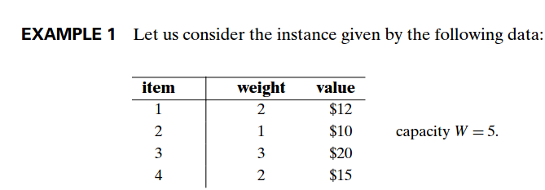
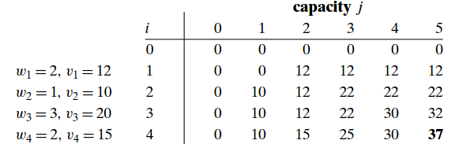
Example

Slide 40
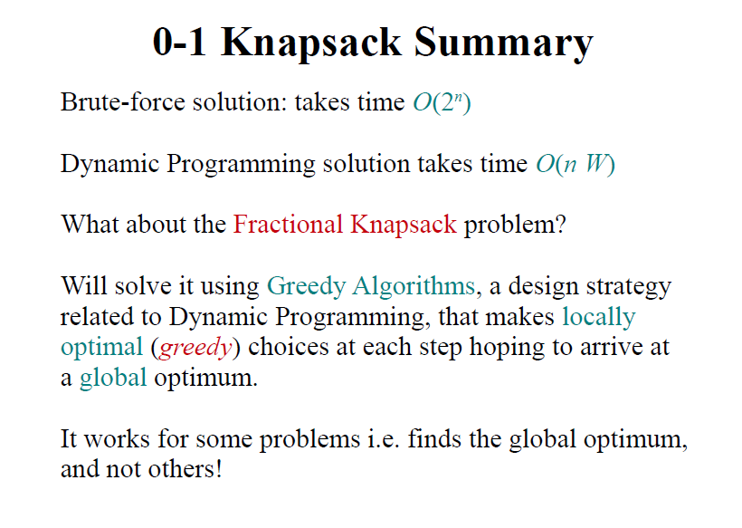

Slide 41
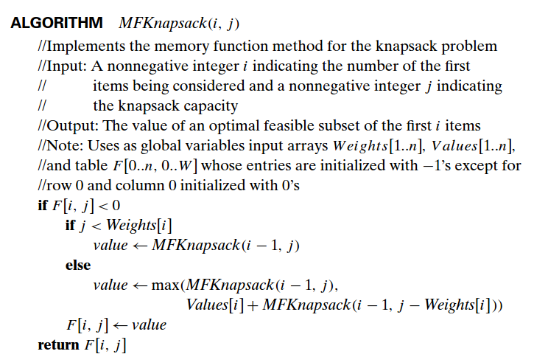
Using Memory function

Slide 42
Rod Cutting Problem
Given a rod of length n inches and a table of prices p_{i} for i =1,2,3,…n, determine the maximum revenue r_{n} obtainable by cutting up the rod and selling the pieces. Note that if the price p_{n} for a rod of length n is large enough, an optimal solution may require no cutting at all.

Slide 43
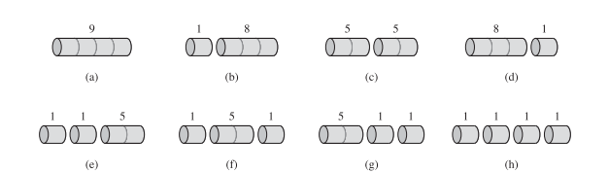

Rod Cutting Problem
Example:
N =4 , we have 2^{n-1} = 2³ ways to cut the rod

Slide 44
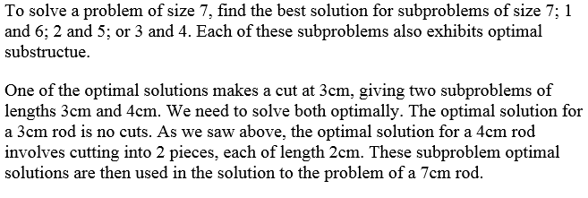
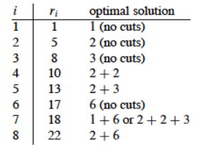

Slide 45
Rod Cutting Problem
If an optimal solution cuts the rod into K pieces (1<= K <= n), then an optimal decomposition
n=i₁+i₂+i₃+……i_{k}
of the rod into k pieces of lengths i_{1,} i_{2, …,} i_{k} provides maximum corresponding revenue
r=p_{i1}+p_{i2}+p_{i3}+……p_{ik}

Slide 46
Rod Cutting Problem
For any rod of length n , the optimal revenue is the maximum of :
p_{n}: the price we get by not making a cut,
r₁ + r_{n-1}: the maximum revenue from a rod of 1cm and a rod of n-1cm,
r₂ + r_{n-2}: the maximum revenue from a rod of 2cm and a rod of n-2cm, ....
r_{n-1} + r₁

Slide 47
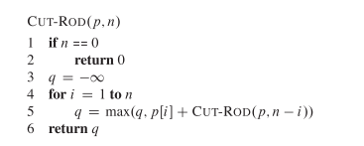
Rod Cutting Problem
Recursive Implementation

Slide 48
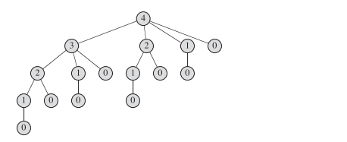
Rod Cutting Problem

Slide 49
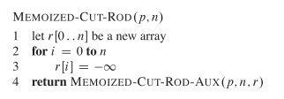
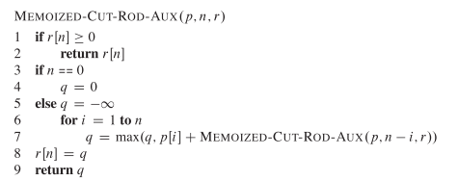
Rod Cutting Problem
Using Dynamic Programming
Top-down : modify the recursive algorithm to store and look up the results in table r.

Slide 50
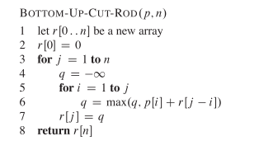
Rod Cutting Problem
Using Dynamic Programming
Bottom-up : sort the subproblems by size and solve the smallest subproblems first

Slide 51
Running Time
Both the top-down and bottom-up versions run in Θ(n²) time.
Bottom-up: there are doubly nested loops.
Top-down: Each subproblem is solved just once. Subproblems are solved for sizes 0, 1, ... n. To solve a subproblem of size n, the for loop iterates n times, so over all recursive calls the total number of iterations is an arithmetic series.

Slide 52
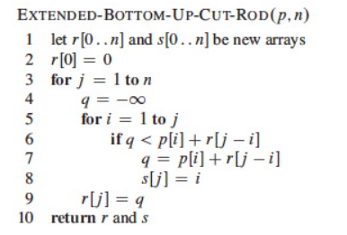
Rod Cutting Problem
Constructing a solution.

Slide 53

Rod Cutting Problem

Slide 54
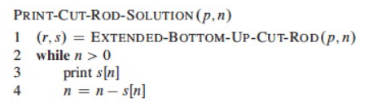
Rod Cutting Problem
Print the solution

Slide 55
Dynamic Programming Steps
There are four steps for solving any problem using Dynamic Programming:
Characterize the structure of an optimal solution
Assume you have an optimal solution and show how it must decompose
Sometimes it is useful to write a brute force solution, observe its redundancies, and characterize a more refined solution

Slide 56
Dynamic Programming Steps
There are four steps for solving any problem using Dynamic Programming:
Recursively define the value of an optimal solution:
Write a recursive cost function that reflects the above structure

Slide 57
Dynamic Programming Steps
There are four steps for solving any problem using Dynamic Programming:
Compute the value of an optimal solution:
Write code to compute the recursive values, memoizing or solving smaller problems first to avoid redundant computation

Slide 58
Dynamic Programming Steps
There are four steps for solving any problem using Dynamic Programming:
Construct an optimal solution from the computed information:
Augment the code as needed to record the structure of the solution

Slide 59
Quiz
Maximum value contiguous subsequence
Given a sequence of n real numbers, a1, a2, ..., an, using dynamic programming find an algorithm for finding a contiguous subsequence for which the value of the sum of the elements is maximized.
What is the time and space complexity of your proposed algorithm?

Slide 60
Next Week DP Problems
Knapsack problem
Weighted interval scheduling problem

